Slide 1
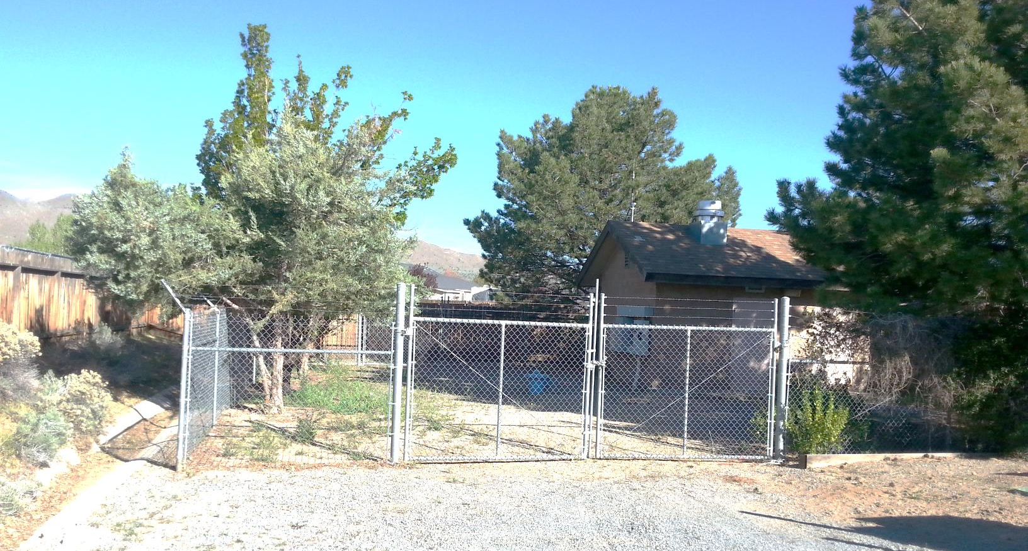
Washoe County Board of Adjustment
June 1, 2017
Special Use Permit Case Number WSUP17-0009
Truckee Meadows Water Authority

Slide 2
Case Description
Hearing, discussion, and possible action to approve a special use permit to allow the construction and operation of a temporary water treatment facility (utility services civic use type) at an existing water well site. The treatment facility is proposed to be located within a tent-structure approximately 15 feet wide, 30 feet long and 15 feet in height. Operation of the treatment facility is proposed for a maximum of 24 months.

Slide 3
Case Description (Continued)
With the review and possible approval of the special use permit the applicant is seeking to vary the following Washoe County Chapter 110 (Development Code) standards: 1) Reduce all required building setbacks for the tent-structure as follows: side yard setback from 8 feet to 5 feet; rear setback from 20 feet to 7 feet; and front setback from 20 feet to 5 feet; 2) Reduce the required amount of landscaping from 20% of the site to that which is currently existing on the site; 3) Reduce the required parking surface from asphalt or concrete to the dirt or gravel currently existing on the site; and, 4) Allow one temporary parking space within the public right-of-way.

Slide 4
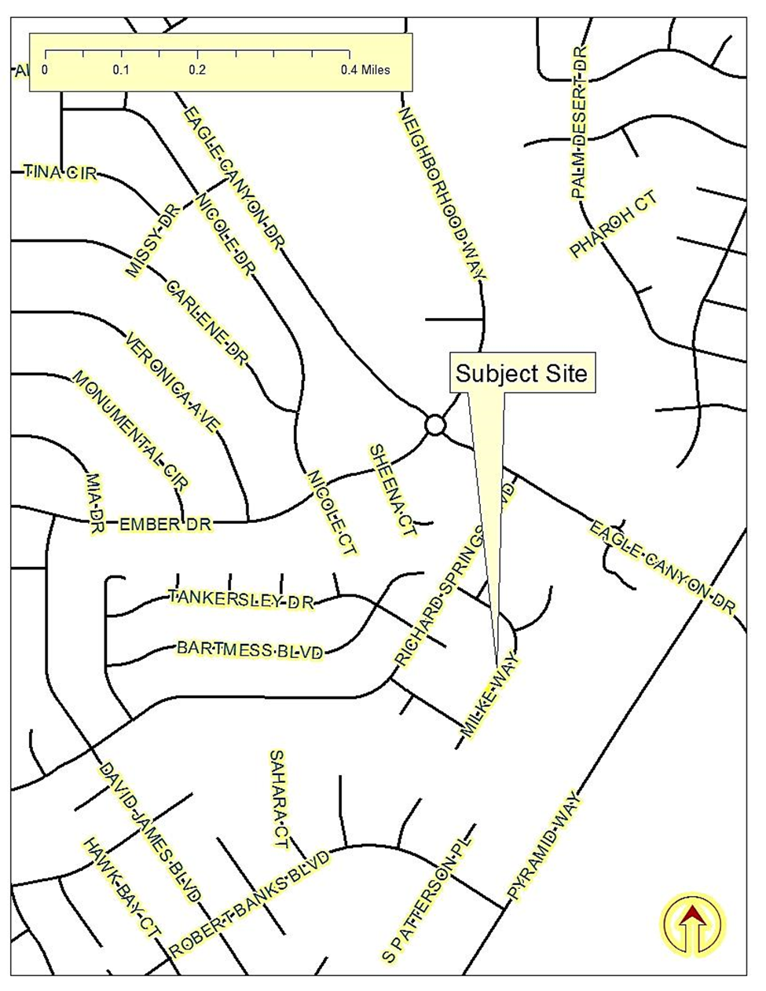
Vicinity Map

Slide 5
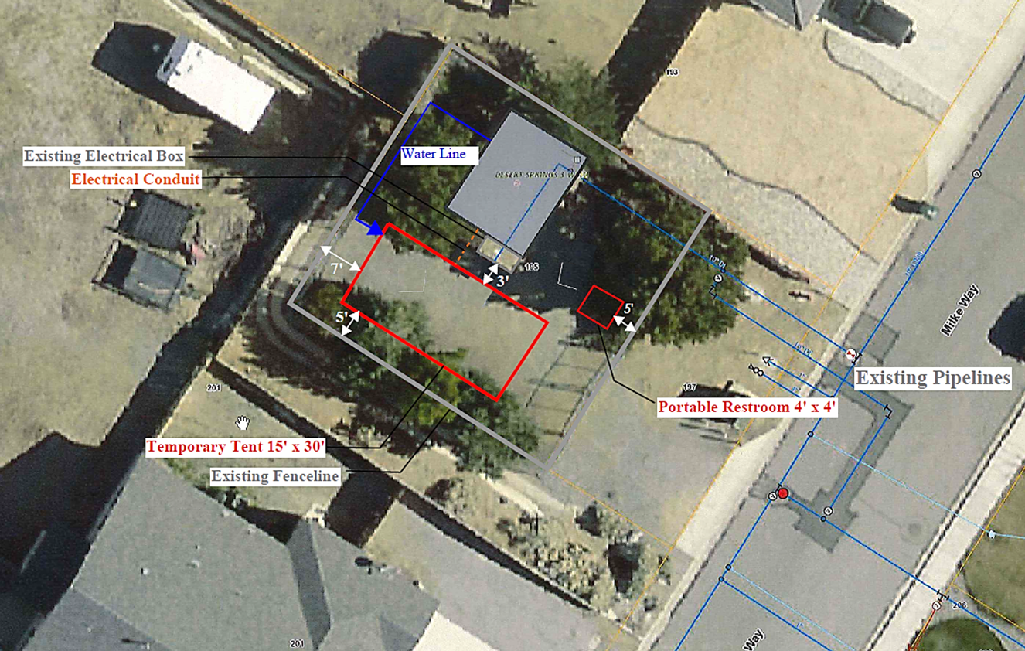
Site Plan

Slide 6
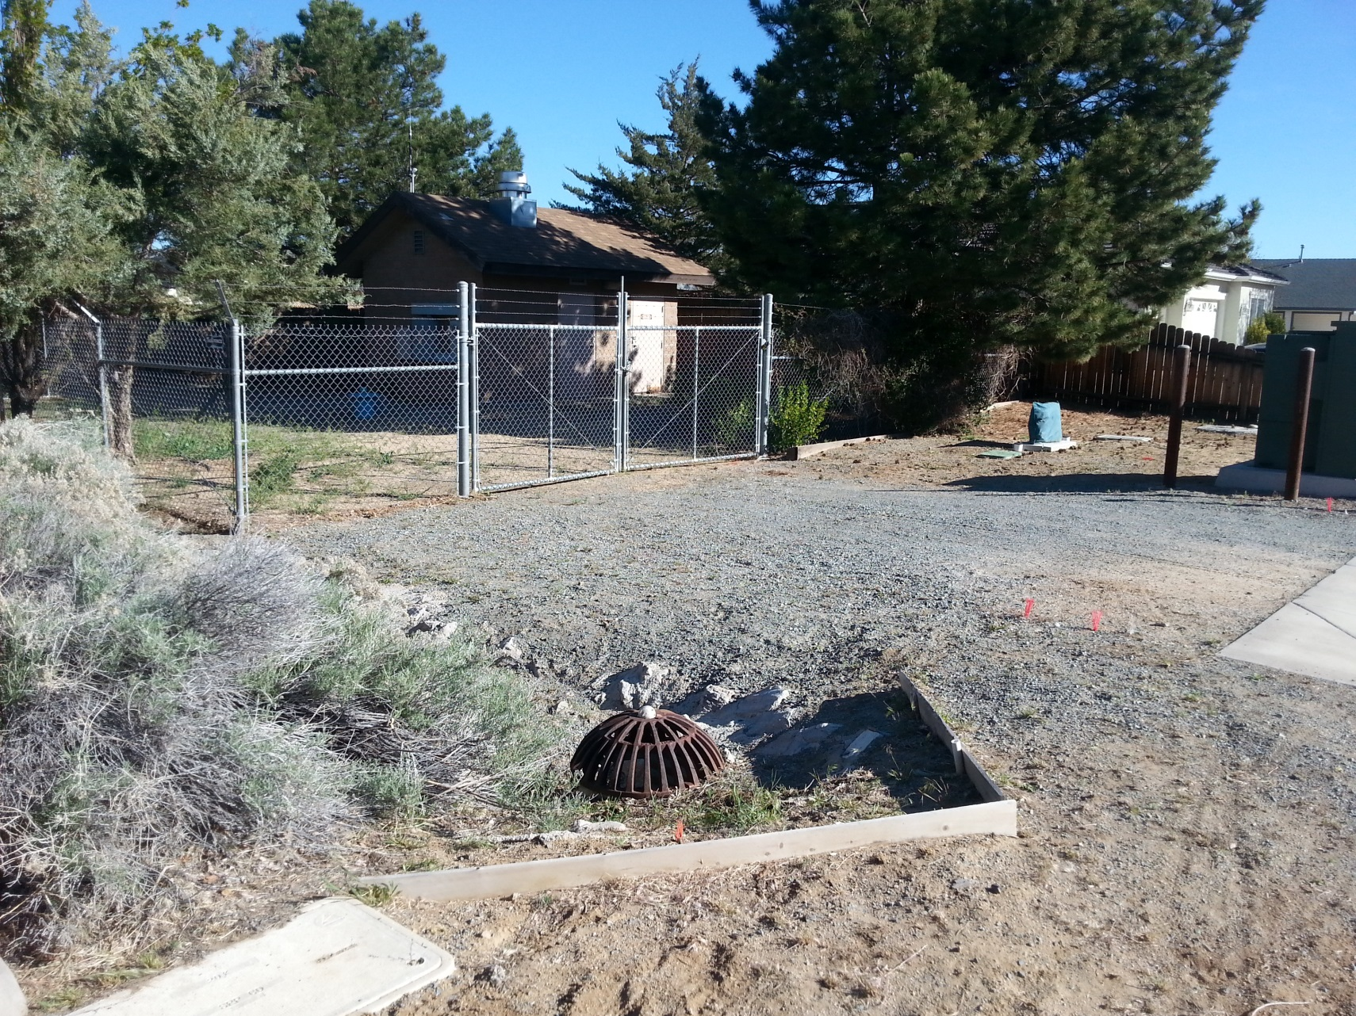
Current Photo of Subject Site

Slide 7
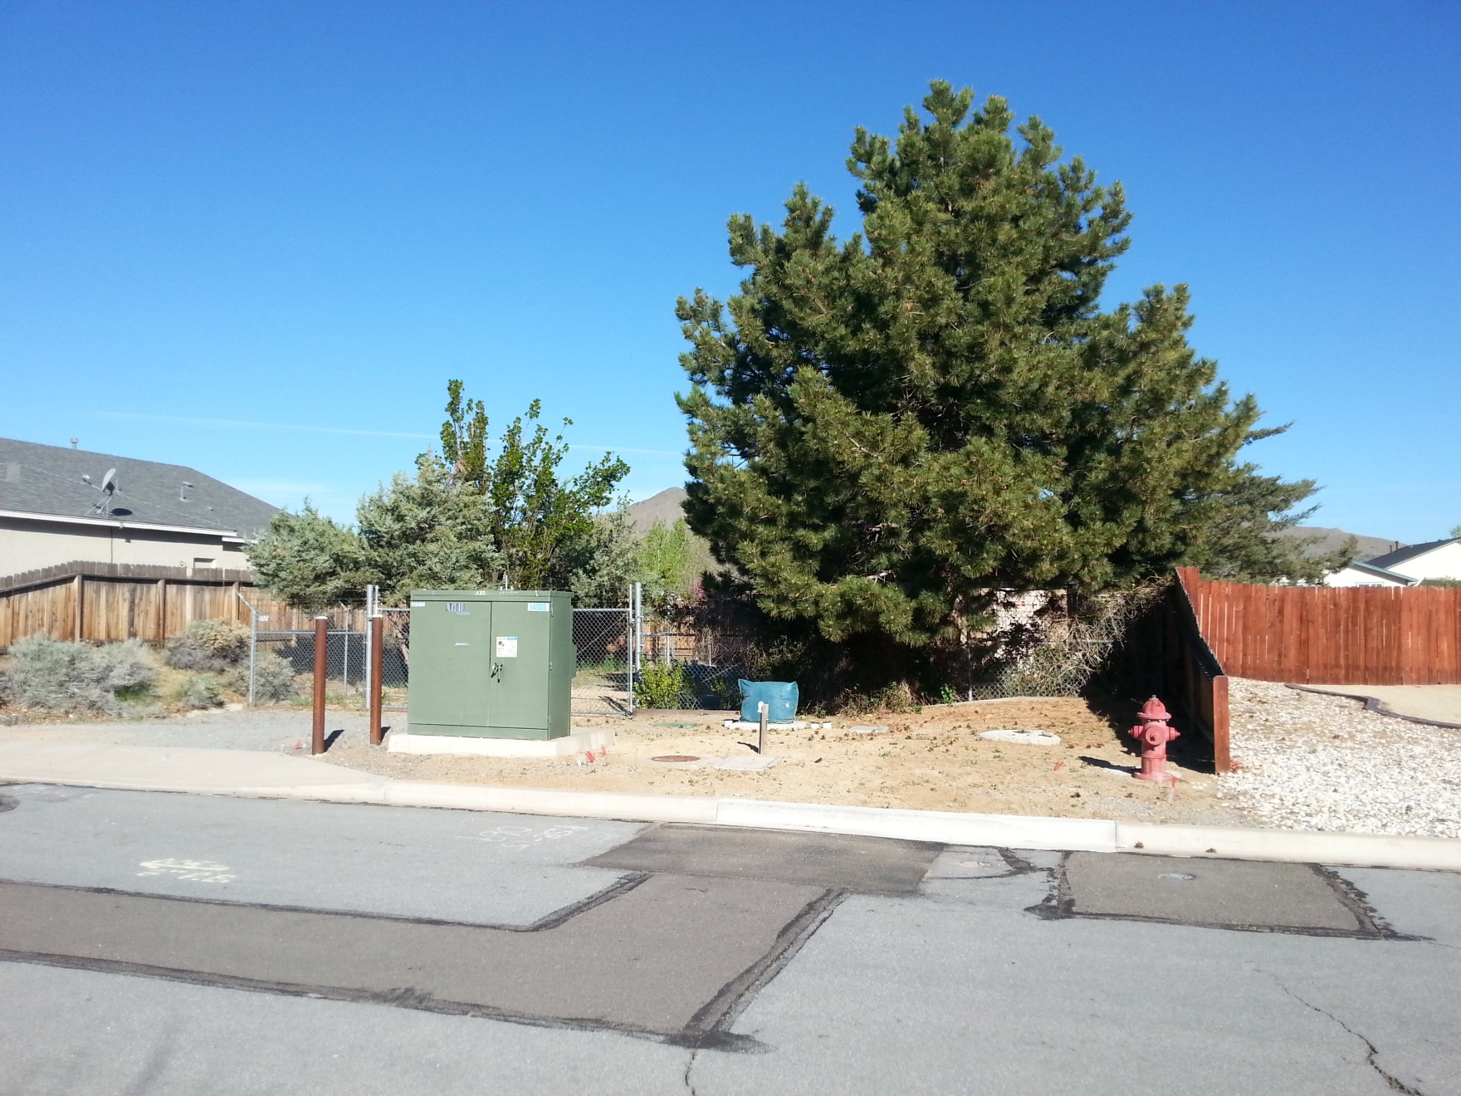
Current Photo of Subject Site

Slide 8
Background
Groundwater in this area, this well particularly has elevated nitrates and arsenic
Current proposal is for a small-scale pilot study of a new treatment system
Proposed for a time of two years
Contained within a temporary tent structure
Parking on site only

Slide 9
Analysis
Potential Impacts:
Proposed temporary structure will not meet required setbacks
Impacts associated with vehicles coming and going
Visual impact of the additional development on the site
Conditions of Approval:
Limited to a maximum of 24 months
Tent fabric be a tan or earth-tone color to blend with the area
8-foot-tall chain-link fencing with slats that provide at least 80% visual screening and that the slats be a similar color as the tent structure
Parking on the street is prohibited
Not operated early or late in the day, on a weekend

Slide 10
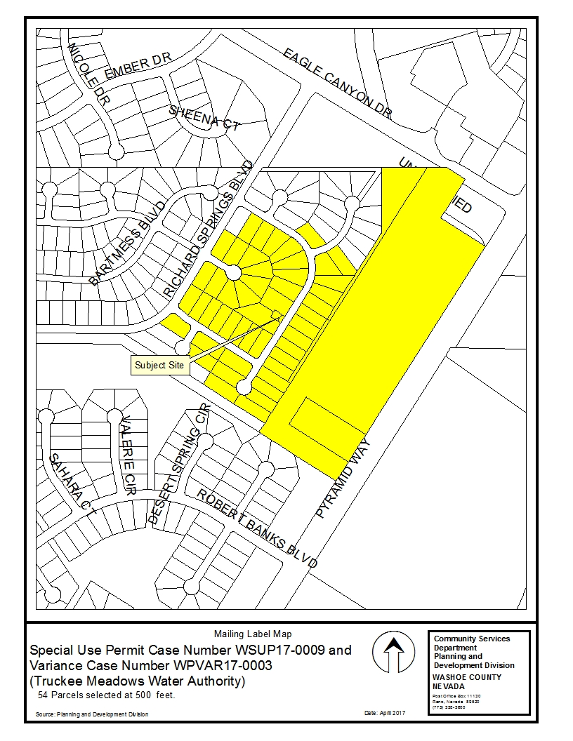
Public
Notice

Slide 11
Citizen Advisory Board
Recommended approval, no negative impacts or comments were stated during the meeting.

Slide 12
Special Use Permit Findings

Slide 13
Special Use Permit Findings

Slide 14
Special Use Permit Findings

Slide 15
Special Use Permit Findings

Slide 16
Special Use Permit Findings

Slide 17
Recommendation
After a thorough analysis and review, Special Use Permit Case Number WSUP17-0009 is being recommended for approval with conditions.

Slide 18
Possible Motion
I move that, after giving reasoned consideration to the information contained in the staff report and information received during the public hearing, the Washoe County Board of Adjustment approve with conditions Special Use Permit Case Number WSUP17-0009 for the Truckee Meadows Water Authority, with the conditions of approval included as Exhibit A to this matter, having made all five findings in accordance with Washoe County Code Section 110.810.30

Slide 19
Questions?

